Slide 1

Ethical and Legal Issues in Caring for Adolescents in ER
Panel

Slide 2
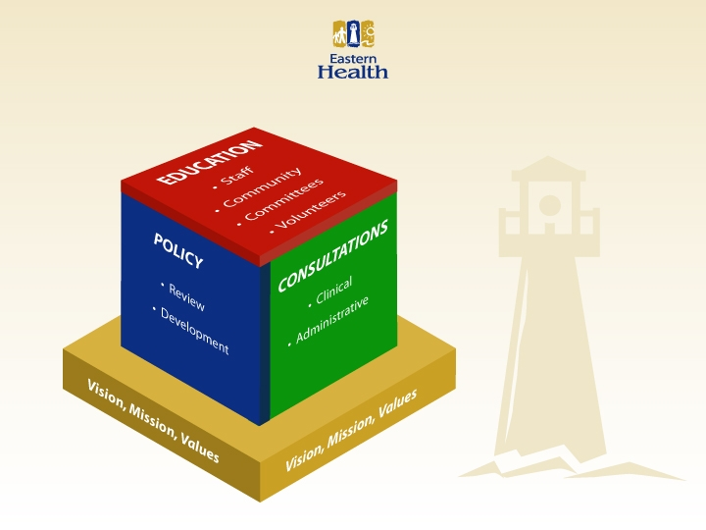

Slide 3
Panelists:
Marian Crowley, RN, Director Access to Information and Privacy
Julie Emberley, MD, Neonatologist and Ethicist
Wendy Zdebiak, Lawyer, Legal Counsel for RNC
Debbie Perry, RN, Risk Mgr, EH
Resource Persons
Wanda Lundrigan, RSW, Asst Deputy Minister, CYFS
Cheryl Bonia, RSW, CYFS
Arlene Scott, RN, MGRS Janeway ER
Attendees: Please participate with experience, comments and questions
Facilitator
Rick Singleton, PhD, Director PC&E EH, and PHENNL

