Slide 1
Care of the Newborn in the First Week of Life
Gail Read, R.N.,B.N.,IBCLC
Janet Fox-Beer, B.N.,R.N.,IBCLC

Slide 2
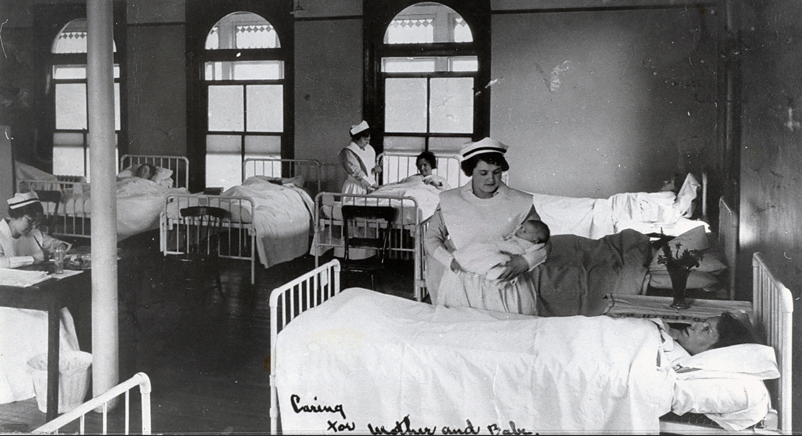
Times, they are a changing!

Slide 3
What’s Different?
1. Prenatal Conditions-maternal health and weight
reproductive technologies
cultural factors
parental expectations
2. Length of Hospital Stay/Early Discharge
3. Family Dynamics
4. Feeding Issues- “On Demand”/BF
5. Community Supports-Internet/GP/PHN/ER

Slide 4
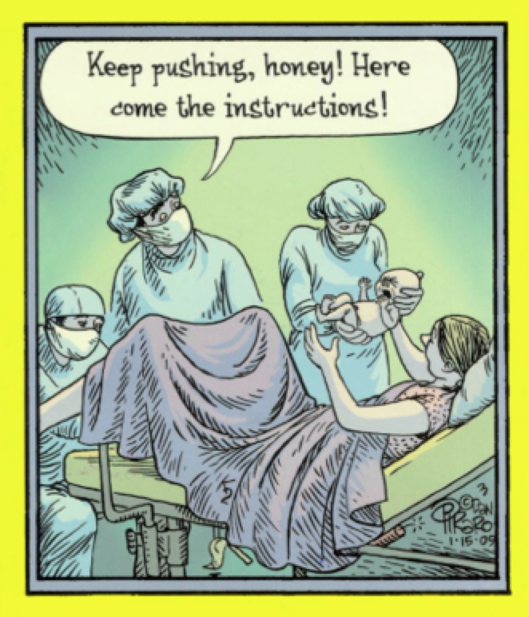

Slide 5
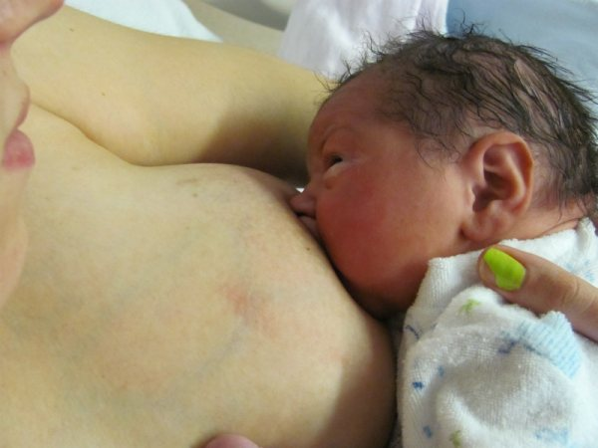
What’s The Same?
Normal newborn transition to life
(Birth through day 28)
Events surrounding the birth process effect newborn and parental adaptation

Slide 6
The Normal Newborn
The Transitional Period:
-Initial period of reactivity = 30-60 minutes
-Skin-to-skin with parent-stabilization, bonding, sucking
-Abnormalities present- resp effort, cardiac issues, sepsis, GI
-Period of relative inactivity =1-3 hours postpartum
-Deep sleep; feeding challenging

Slide 7
-2nd period of reactivity = 4-6 hours postpartum
-May pass urine, first meconium
-Early feeding cues key/rooming-in
-Monitor temp, resp, jitteriness, tone, glucose
-Understand normal fluid balance
-Parent bonding & learning happens!

Slide 8
What is the emerging role of the emergency department in newborn care…?

Slide 9
Who’s Coming?
NL Healthline/Janeway Emergency Dept
(Patient admissions to NICU)
1.Neonatal Jaundice
2.Pyloric Stenosis
3. Neonatal Esophageal Reflux
4. UTI
5. URTI (RSV, bronchiolitis)
6. Feeding Related Concerns ( dehydration, hypoglycemia, weight loss)
NB: 2012-2014-74% had mean weight of 3.5kg
Thanks to Mr. Phil Murphy (Data Consultant PPP)

Slide 10
COMMON CONCERNS
1. Hypoglycemia
2. Jaundice
3. Neonatal Sepsis
4.Feeding Difficulties

Slide 11
I. HYPOGLYCEMIA
-Definitions (controversial) current CPS =1.8mmol/L x1; 2.6 mmol/L>1
JCHC policy corresponds to current CPS Position Statement
-Prophylaxis to ID at risk infants
-Aimed to prevent unnecessary formula supplementation (BFHI)
-Maternal circulation source terminates ~1hour after birth; liver glycogen stores after 3-12
Measured at 2 hours of life after initial feed at 30-60 minutes of age
Checked on all asymptomatic at risk infants
Repeated, q3 prior to feeds
Notes:
ACoRN (Acute Care of at-Risk Newborns) states that “Glucose is the main source of energy for brain cells. An adequate blood glucose concentration is essential because neurological compromise can occur if the brain is deprived of glucose.”

Slide 12
At Risk Infants:
Infant of Diabetic Mother (IDM)-Type 1/11
Preterm (<37wks)
SGA ( BW<10th%)
LGA (BW>90th%)
Babes stressed by sepsis, shock, asphyxia, hypothermia

Slide 13
S/S of Hypoglycemia
- jitteriness, sx
- irritability ,lethargy ,stupor
- hypotonia, limpness
- exaggerated Moro reflex
- apnea or cyanotic spells
-poor sucking/poor feeding reflex
-hypothermia
-high pitched cry

Slide 14
Practice
Skin-to-skin ASAP after birth… ALL infants-
Regardless of feeding choice! ( unless medically contraindicated)
Measure glucose at 2 hours of life after initial feed at 30-60 minutes of age
Checked on all asymptomatic at risk infants
Repeated, q3-6h prior to feeds x 24-36 h
*At risk moms may express and store colostrum prenatally for prn use postpartum!

Slide 15
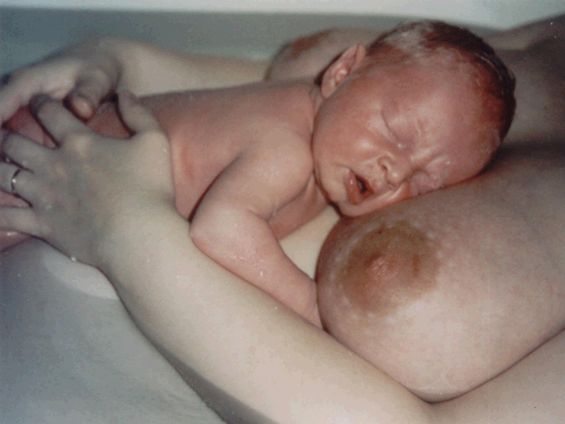
Ensure infant is fed (>q3h)
-best result follows exhibiting early feeding cues ;crying is a late cue!
Use STS to enhance feeding readiness and neuro-coordination of suck/swallow
If BF babe not keen: -mom express colostrum to feed via syringe,spoon,cup
Be familiar with medical indications for supplementation ( poor feed-use measured volume 10ml/kg; good feed 5ml/kg)
Check glucose 1 hour post-feed and reassess Rx

Slide 16
Ensure infant is fed q3h
Respond to early feeding cues for optimal feeding ability
If BF babe not keen, mom can express colostrum and feed via spoon, cup
Be familiar with medical indications for supplementation (5-10 mls/kg)
Check glucose 1 hour post- supplemental feed

Slide 18
Guidelines for Care
1) Symptomatic Infants = Rx with IVF D10
2) Asymptomatic Infants (not able to maintain BG >or =2 mmol/l, despite feeding), may need IV dextrose, as ordered
BF Babes- may continue to nurse ) colostrum= small fluid volume
BMS Babes- enteral + IV Rx intake not to exceed 100ml/kd/day (to avoid overhydration/ hyponatremia)

Slide 19
II. JAUNDICE
Newborn liver metabolizes bilirubin .
Bilirubin = yellow pigment formed from hemoglobin as a byproduct of the breakdown of RBC’s.
Unconjugated, fat-soluble (indirect) bilirubin is bound to circulating albumin in blood stream ( not yet met. by liver).
Gets carried to liver, which uses glucose, oxygen and the enzyme, glucuronyl transferase to convert it to conjugated, water-soluble (direct) bilirubin.
Notes:
EH Policy available in DRAFT only at present.
In late gestation, fetal liver increases glycogen storage in preparation for NB transition. Glycogen maintains homeostasis immediately after birth, using ~90% of liver glycogen stores in the first 24 hours.
Liver also plays a major role in metabolism of bilirubin.

Slide 20
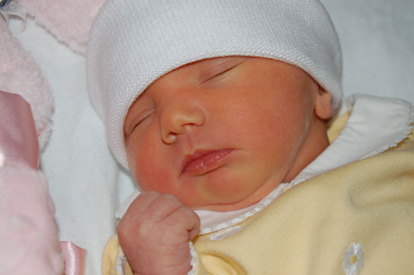

Slide 21
Direct bilirubin is excreted into small intestine and processed into urobilinogen (orange color)
Excreted in stool.
May have enterohepatic shunting
Sees unconjugated, indirect bilirubin absorbed across the intestinal mucosa and its re-entry into the circulation, ending up back in the liver.
Any delay in intestinal movement or increase in flora increases the risk of direct bili converting to indirect bili.

Slide 22
NB Jaundice progresses from head to toe (cephalocaudal)
Check by pressing a finger on the skin and observe color prior to capillary refill.
Visible jaundice usually when serum levels = 85-120micromoles/L in the first few days after birth.
In high concentrations, bilirubin is toxic to the brain “ Kernicterus” =SO RARE! (only 2% reach bili of >340 micromoles/L

Slide 23
Normal /”Physiologic” Jaundice
~60% NB’s =SO COMMON!
Peaks 3-5 days –usually after D/C from hospital !
Usually disappears in 7-10 days – may take longer –maybe weeks!
Skin, sclera may appear yellowish
If babe feeding/stooling well, urine clear/hydrated, maybe a “protective”, antioxidant response for later in life

Slide 24
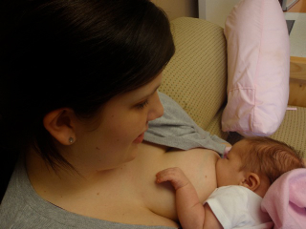
Breastmilk Jaundice
-Occurs in babies >1 week of age BF well,
Well hydrated and normal BM’s
Peaks at 10-21 days
May last for 2-3 months
If abnormalities are R/O and babe feeding optimally…=NORMAL!

Slide 25
“Hyperbilirubinemia” as a Concern:
1. Rh- mom with Rh + babe/ABO incompatibilty
( mom forms antibodies against babe’s Rh+ factor and destroy babe’s RBC’s…jaundiced at birth ) – Rhogam pre/postnatally helps Rx
2. Blood dyscrasia in babe ( eg- sphirocytosis)
3. Antenatal infections (CMV+)
4. Bruising
5. Prematurity ( late preterms at highest for re-admission ! )

Slide 26
EH Detection/Mgmt Policy:
1. All NB assessed for hyperbilirubinemia risk factors
2. Notify physician or NP if NB jaundiced in 1st 24 hours…Rx with phototherapy, p.r.n.
3. Monitor Bilirubin q6 -24h during Rx and when a change in intensity is ordered
4. Assess jaundice with V/S (>q8h)
5. Support adequate feeding regime

Slide 27
Universal Screening- by 72 hrs of age
…? Early D/C…?
Rx’s
1. Phototherapy lights/ Biliblanket
(In combination or alone if BF babe)
2. IVIG ( acts as inhibitor to antibodies that cause RBC destruction )
3. Critical= Exchange transfusion

Slide 28
NB- Infants can have Skin-to-Skin and BF if levels not critical range. Use biliblanket! Protect BF
Supplementation with water or dextrose water has NOT been effective Rx to decrease TSB and should NOT be used!
D/C Phototherapy once TSB fallen to >30 micromoles/L below phototherapy threshold for gestational age and age in hrs
If high intensity Rx used, switch to conventional Rx once TSB is 50 micromoles/L less than exchange threshold
Check for rebound hyperbilirubinemia 12-24 hrs after D/C Rx
Ensure adequate feeding of infant and proper f/up

Slide 29
Prevention Strategy…Adequate Feeding!
-Optimal intake (BF or BMS) ensures BM to excrete conjugated (direct) bilirubin
-If supplementation required for the BF infant, follow recommendations for preference:

Slide 31
…Follow-up!!!!
Phototherapy is useful to Rx JAUNDICE, but the underlying problem must be addressed.
If feeding activity is suboptimal, the root cause must be fixed
Dehydration and Jaundice + comorbidities!!
R/O infection (presents with same s/s)

Slide 32
Increased Direct Bili
-Conjugated/ water- soluble bili builds-up
-Usual cause = liver pathology!
-Urine appears brownish, even if well hydrated
-O/E: liver and possibly spleen enlarged
-Causes could be Biliary Atresia, Hepatitis, Drugs/Toxins, Galactosemia ( may have to D/C BF)

Slide 33
III. NEONATAL SEPSIS
Invasive infection, usually bacterial with systemic S/S
-lethargy
-hypotonia (suck as well)
-apnea
-bradycardia
-temperature instability
-respiratory distress
-vomiting/diarrhea
-abd. distention
-jitteriness/seizures
-jaundice

Slide 34
ONSET
A. Early Onset ( </=3days)
Results from organisms acquired intrapartum
S/S usually by 6 hrs of age
Most common single organism= Group B Strep
Incidence =2/1000 in absence of intrapartum antibiotic prophylaxis (IAP)..Mortality is 2-13%

Slide 35
Practice Guidelines
SOGC recommends preventative strategies
-routine rectovaginal cultures on all mothers at 35-37wks
-treat those + for GBS when they present in labour (~22% Rx to prevent disease in 0.2% and mortality in 0.01% of infants)

Slide 36
-S/S …generalized/subtle !
-Progression ….rapid!!
-NO clear distinction in clinical s/s of GBS vs other invasive organisms
-Rx immediately following prompt, diagnostic work-up
-Delay b/w presentation and Rx =POOR outcome!
-Obtain cultures but DO NOT wait to confirm tests results!

Slide 37
Diagnostics:
-1. CBC
-2. V/S q4h minimum x 24h
-3. Full workup = blood cultures, LP, CXray

Slide 38
Treatment Categories:
-1.Well infant; GBS- mom with risk factors at delivery = limited investigations; routine NB care
-2.Well infant; GBS? mom with no risk factors = routine NB care
-3.Well infant; GBS? mom with risk factors = Treat as if GBS+ = a) IAP>4hrs before delivery; routine NB care b) IAP<4hrs before delivery or no IAP; limited Dx and minimum 24hrs observation
-4. Late preterm infant 9<37wks)…no GBS results available = has risk factor of prematurity BUT f/up any risk factors with Rx and no D/C < 48hrs old

Slide 39
-5. Chorioamnionitis = Dx when triad of fever, increased WBC’s and lower uterine tenderness (histology may/not correlate)
-6. Well infant (>35wks); GBS+ mom who received IAP >4hrs prior to delivery =routine NB care and observation for 24hrs
-7. Well infant (>35wks); GBS+ mom who received IAP ,4hrs prior to delivery or NOT all = close observation for 24 hrs and Rx at 1st s/s (95% of +infants present)…4% 24-48hrs; 1% >48hrs

Slide 40
B. Late Onset
…Is usually acquired from the environment
RISK Factor+++…preterm delivery!
1.Gram + organisms (eg.staph)-IV ‘s; skin
2. Gram – organisms (e.coli)-feeds; endogenous flora altered by antibiotic Rx
3.Candida - opportunistic; antibiotic use; indwelling lines

Slide 41
Common Clinical Manifestations of Sepsis:
1.GBS+
2. Pneumonia
3. UTI
Treatment :
Ist = Amp + Gent or Cefotaxime
2nd = Organism-specific drugs ASAP

Slide 42
IV. FEEDING DIFFICULTIES
-Broad category
-May be cause OR result of morbidity
-Major reason for parental stress &/or calls to the Health Line; visits to ER/NICU
-Complicated by conflicting advice, outdated information, cultural practices

Slide 43
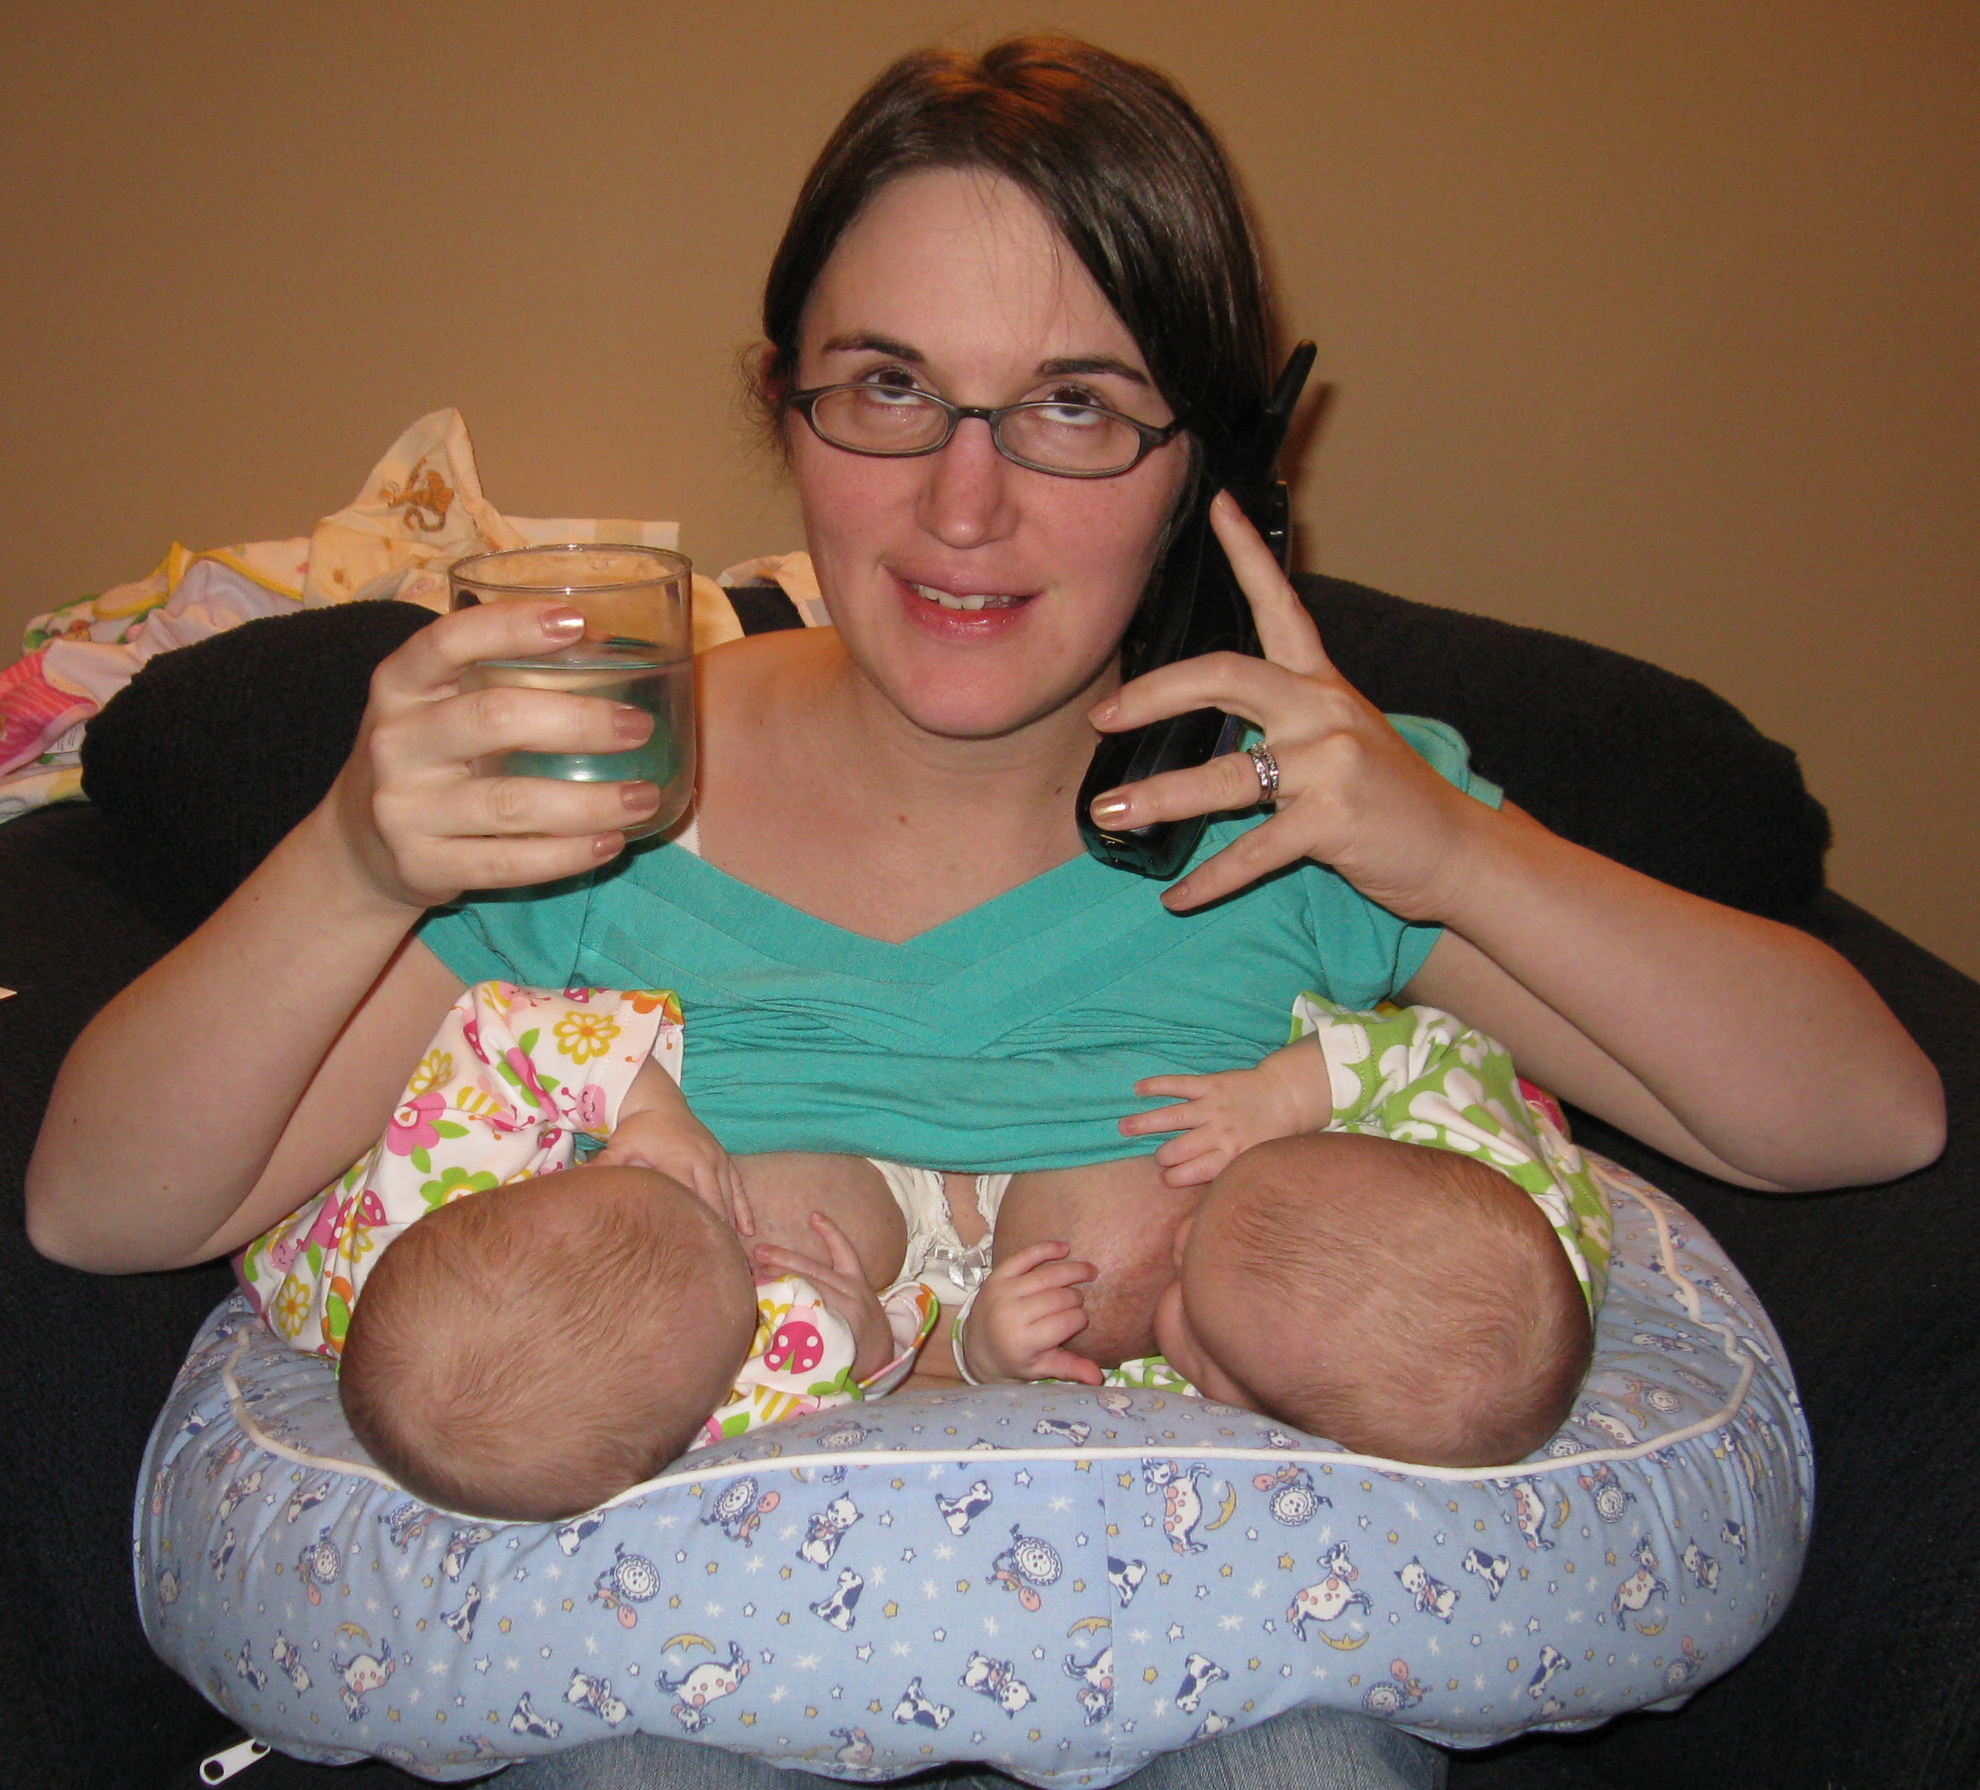

Slide 44
PYLORIC STENOSIS
Narrowing and thickening of the muscle of the pylorus (the valve that opens from the stomach into the small intestine).
Familial; boys > girls
Prevents stomach contents from emptying
Results in vomiting

Slide 45
Signs/Symptoms:
-projectile vomiting
-no nausea; hungry after vomit; feeds again!
-may or may not vomit after every feed
-usually presents at ~3weeks of age, but may be b/w 1 week-5 months of age

Slide 46
Also…
-abdominal pain
-burping
-constant hunger
-dehydration (progressively worsens)
-wt loss/FTT
-wave-like motion in abdomen,post-feed/pre-vomit
-olive-shaped mass palpable in upper abd (pylorus)

Slide 47
Diagnose with abd U/S; Ba swallow; B/W
Rx with surgery (pyloromyotomy, using endoscopic balloon to widen pylorus)
Prognosis = positive!

Slide 48
2. REFLUX ESOPHAGITIS and GERD
Acidic stomach contents flow back up through the immature sphincter into the esophagus
Causes significant –inflammation to the esophagus pain and pain to the infant!
Feedings are self-limited due to negative conditioning –babe knows pain will come!
R/O – Allergy, obstruction, eosinophilic esophagitis

Slide 49
Signs and Symptoms
-poor weight gain
-spits up, often forcefully
-may spit up old blood
-refuses feeds (breast or bottle)
-difficulty breathing

Slide 50
Management
-position reclined, not flat , during feeds and for 20 minutes post-feeds (chalasia positioning)
-avoid abdominal straining post-feeds (if possible)
-shorter, more frequent feeds/ frequent upright burping
R/O cows’ milk allergy ( eliminate from maternal diet if BF; switch to hydrolyzed BMS )

Slide 51
3. INFANTILE COLIC
-CPS (Dr. Jeff Critch)
“A behavioural syndrome of early childhood, associated with irritability and crying…self-resolves…”
-Source of parental strife!
-S/S =
a) irritability; crying that randomly start/stop,
b) episodes last >3h; 3x/week for at least 1 week,
C) no FTT

Slide 52
Diagnosis
-U/S,B/W to R/O other pathologies, esophageal pH monitoring, upper GI series, upper endoscopy
Treatment
-positioning
- medications (eg. ranitidine)

Slide 53
Treatments:
1. R/O pathologies
2. Support for parents – EDUCATION !
3. BMS babe – switch to hydrolyzed formula
4. BF babe- confirm proper latch
- hypoallergenic/avoidance diet for mother ( i.e. remove cow’s milk)
*Soy-based BMS not recommended unless Dx/o galactosemia OR parental cultural/religious beliefs
* No evidence for use of lactase Rx
*Probiotics/prebiotics…? + More studies needed

Slide 54
4. ANKYLOGLOSSIA
A) Lingual frenulum restriction (stages I-IV) Anterior; Posterior (submucosal)
B) Labial frenulum attachment

Slide 55
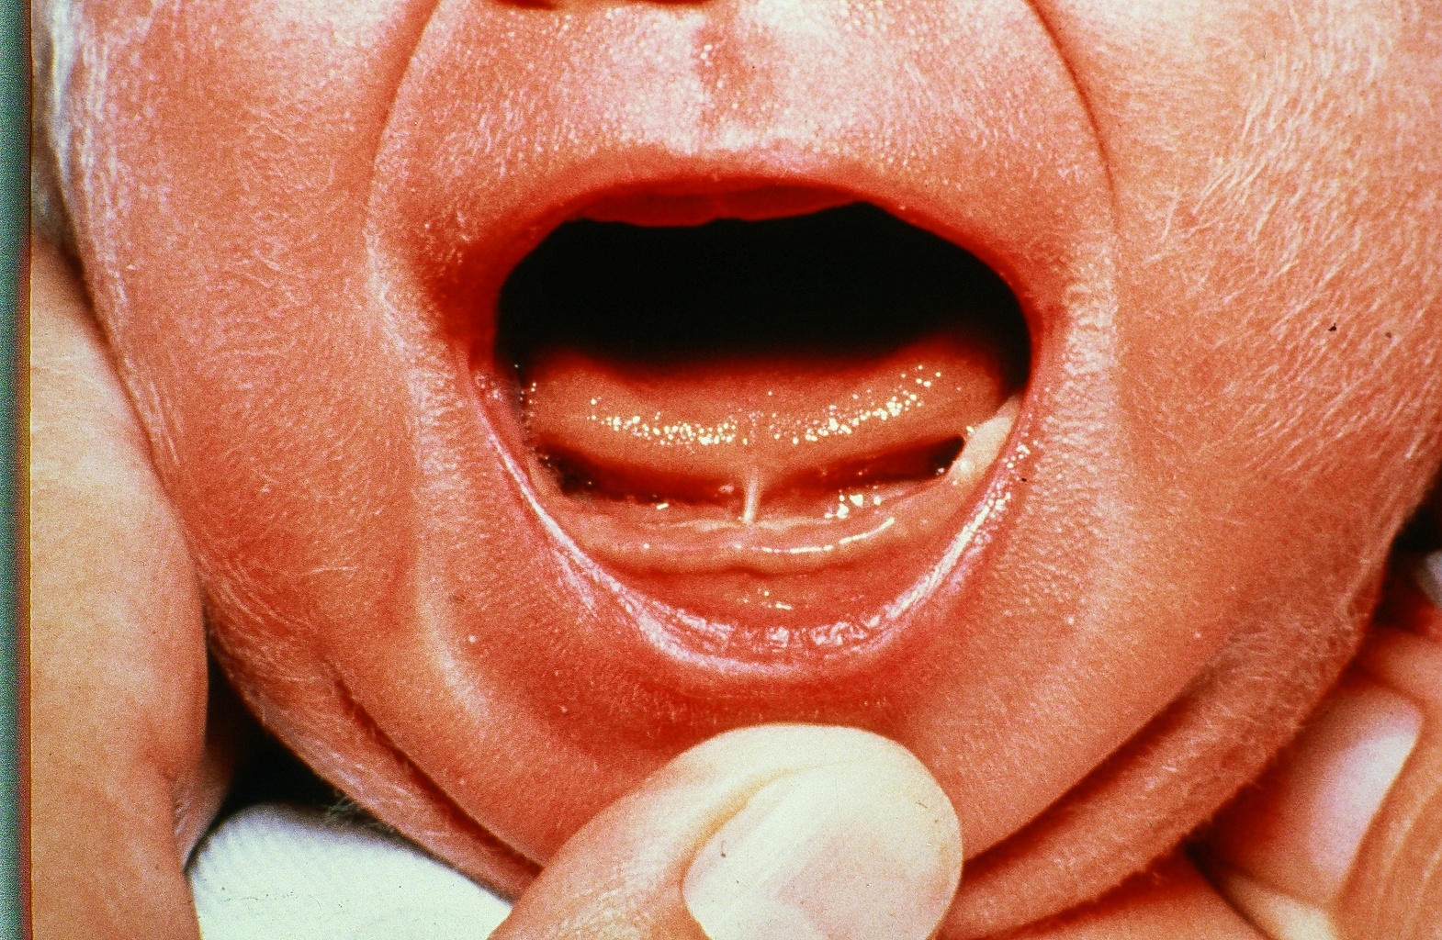
Photo of tongue tie

Slide 56
“Infancy” of understanding the sequelae
Affects BF and BMS fed babies
Familial occurrence
Immediate affect on feeding practices ( wt gain, GI upset, susceptibility to yeast, ,BF relationship)
Long-term affects on speech/dental/ self-esteem

Slide 58
Treatments
a) Latch optimization
b) Frenotomy/ frenectomy (post-Sx exercises)
c) CST
d) Parental support

Slide 59
5. INADEQUATE NUTRITIONAL INTAKE
A) BMS- see safe preparation recommendations from WHO
B) Breastfeeding – full assessment

Slide 60
A) BMS – Fed Baby
1. Complete assessment, HX to R/O pathology
2. Assure recommended commercial, iron-enriched formula
3. Ensure safe BMS preparation followed)(parents comprehend mixing/dilution/exp)
BFI recommendation !!...OBS/Community?
4. Ensure adequate volumes consumed and tolerated (“On Demand” suggested volumes widely vary –eg. “At Birth = 14-22 oz/day =total 410-650mls/day, divided by 6-10 feedings/day)

Slide 62
SAFE Preparation: Using sterilized bottles/nipples
1. Powdered BMS is NOT recommended for infants
< 2months AND for those with immune compromising conditions
2. Powdered forms are NOT STERILE and risk containing E.sakazakii or E.coli
3. To reconstitute must mix with water that is not<70 degrees C.
4. Water must boiled for 1 full minute (NO rolling kettles!) to reach 100 degrees C and then cooled down to 70 degrees to reconstitute. Using hot water to reconstitute may lead to clumping.
5. DO not leave it for >30 minutes before preparing. Cool bottle to 37 degrees (~skin temperature) before offering to baby.
6. NEVER warm in a microwave (hot spots)!
*Typically good for 24 hrs in fridge once prepared (check manufacturer).
* Once taken out of fridge, D/C in 2 hours. Throw away leftovers!

Slide 63
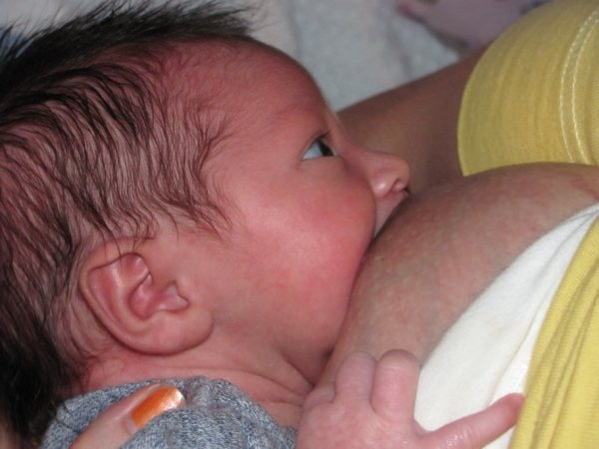
B) BF- Baby
1. Complete assessment, HX to R/O pathology
2. ASSESS LATCH and optimize for effective milk transfer
3. Do oral suck assessment
4. Confirm BF goals and intents
5. Assess family/cultural supports/. Ensure connection to BF HCP/resources/peers
6. Review basic lactation physiology knowledge with mother and support person, ideally

Slide 70
“The most important
practical lesson that can
be given to nurses is to
teach them what to
observe.”
- Florence Nightingale

Slide 72
Role of the of the Milk Ejection Reflex
Oxytocin is a “permissive” not a regulatory hormone
Pulsatile releases from posterior pituitary, initially as “letdown” and throughout feeding session
Elicited by stimulation of 4th,5th,6th ICN’s; breast massage also raises oxytocin blood levels
Psychosomal (emotions/stress affect the release)
Results in contraction of myoepithelial cells of alveoli (milk cells)

Slide 75
ALTERNATE FEEDING METHODS
1.Cup Feeding
2.Finger Feeding
3.Lactation Aid
4. BF with Nipple Shield
5. Bottle

Slide 80
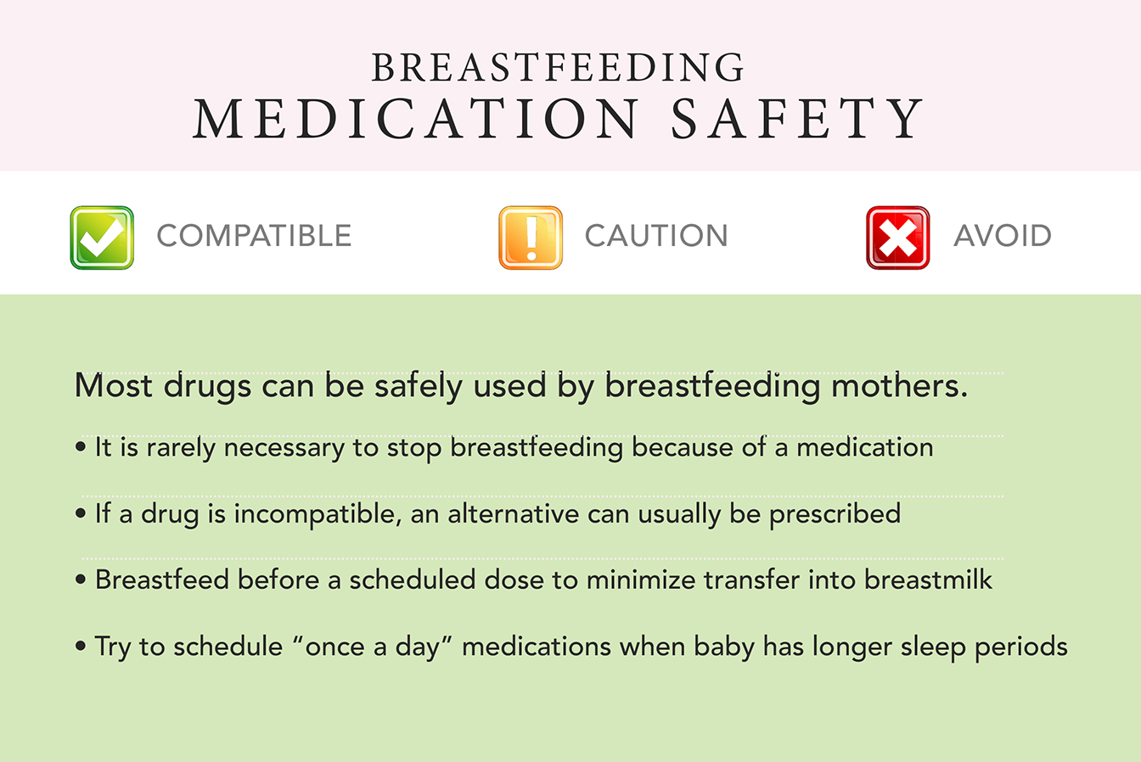

Slide 81
SUMMARY
1. Babies and families continue to have needs.
2. Neonatal conditions of risk “evolve” with the culture of a community and the social determinants of health affecting its people.
3. Emergency departments have become the link between inpatient acute care and home adaptation for new families.
4. Collaboration of HCP’s, especially in the foundation 1st week of life, is a vital “best practice” because times are changing and because…

Slide 82
KIDS ROCK !!

