Slide 1
Am I Going Home?

Slide 2
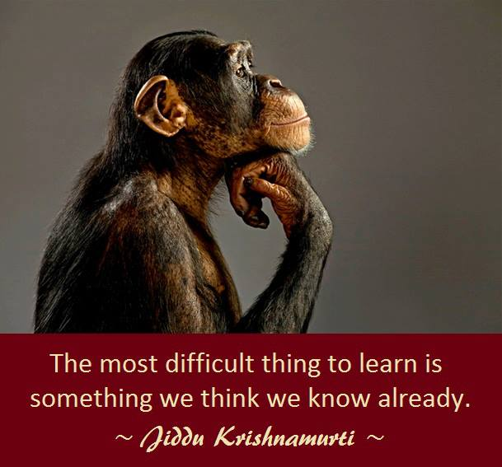

Slide 3
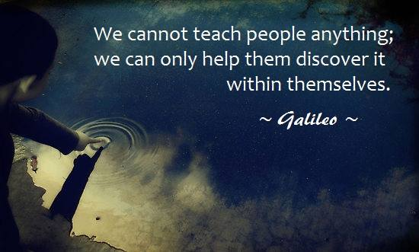

Slide 4
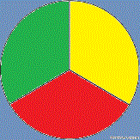
Aristotle’s View
Art of Discourse
Ethos Logos Pathos
Ethos is Credibility / achievements/ experience
Logos is data, logic and statistics
Pathos is appealing to emotions/feelings

Slide 5
Intent of this presentation
It’s not to engage your mind
It’s not to add more facts

Slide 6
To arrive at a place,
when you step out of your mind stream

Slide 7
Seeking Longing
Knowledge Wisdom

Slide 8
Model of Reality / Home
Thoughts
Thoughts Thoughts
Thoughts
Attention

Slide 9
Intellectual
This presentation will not work at an intellectual level
This presentation will work at experiential level

Slide 10
The space in which our
attention perceives everything

Slide 11
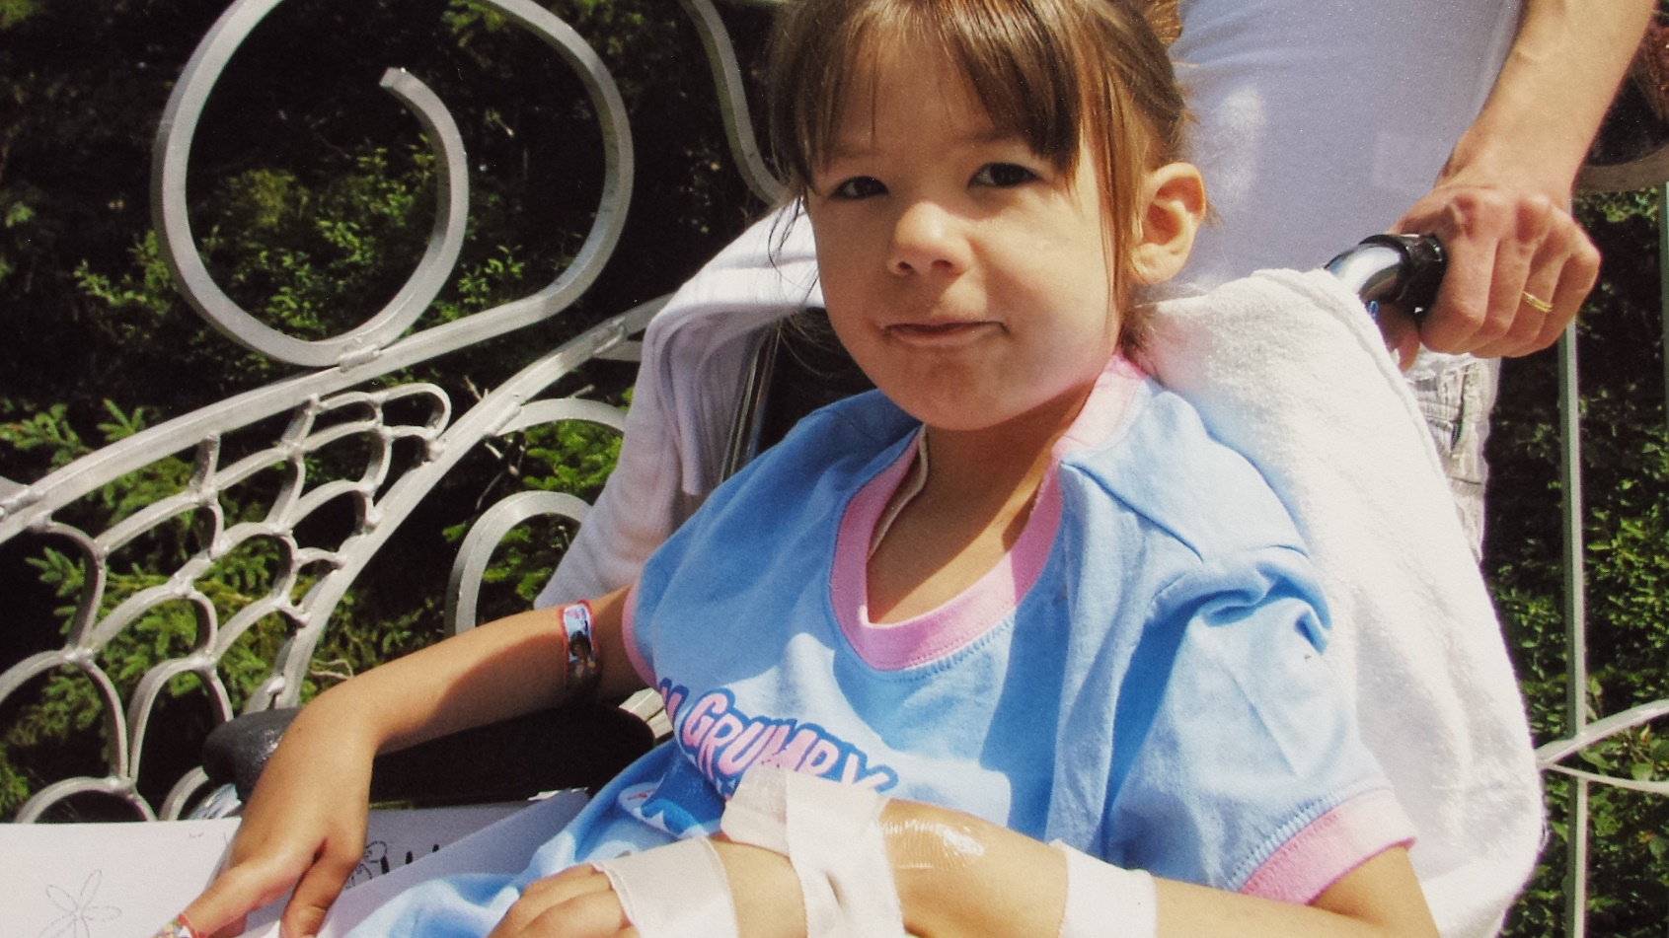
Destiny

Slide 12
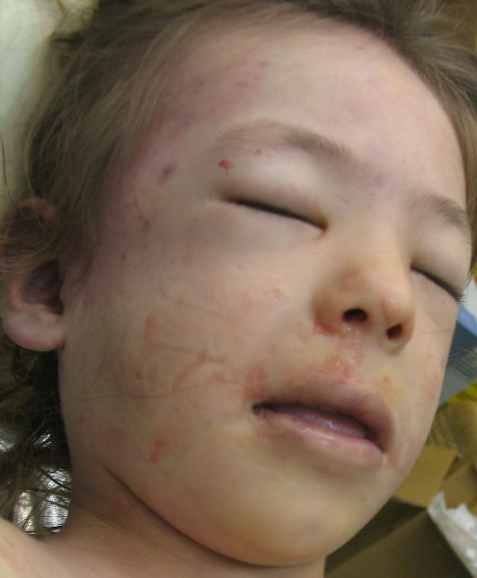
Grace under Pressure
7 Year Old Child and her graceful exit
Prophetic last words, “Am I going home?”

Slide 13
Anchored to something
which was formless and timeless

Slide 14
Wellbeing and Good Health
The Disease Model
- Pneumonia
- Hernia
- Leukemia
- Depression

Slide 15
Western Model Eastern Model
Healthy Sense of self Dissolve our sense of self

Slide 16
Outer World →Separateness and Time
Inner World →Creates Oneness

Slide 17
Linear
Circular
Past / Future / Past / Future
- - - - - -

Slide 18
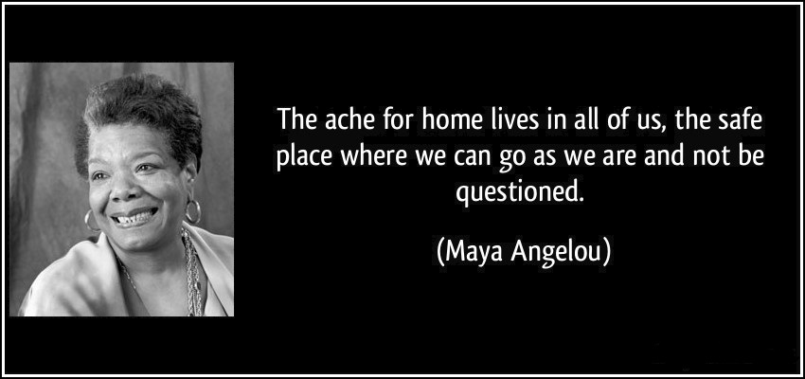
Going Home ?

Slide 19
The external conditions of our world, often create conditions of exclusion

Slide 20
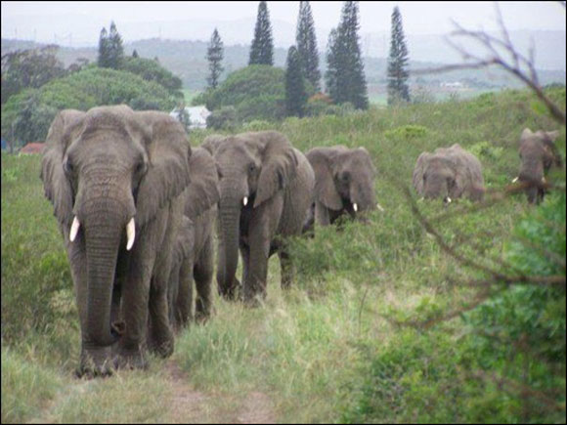
The Elephants Knew
Lawrence Anthony

Slide 21
Melissa
Accepting Adversity & Coming Home

Slide 22
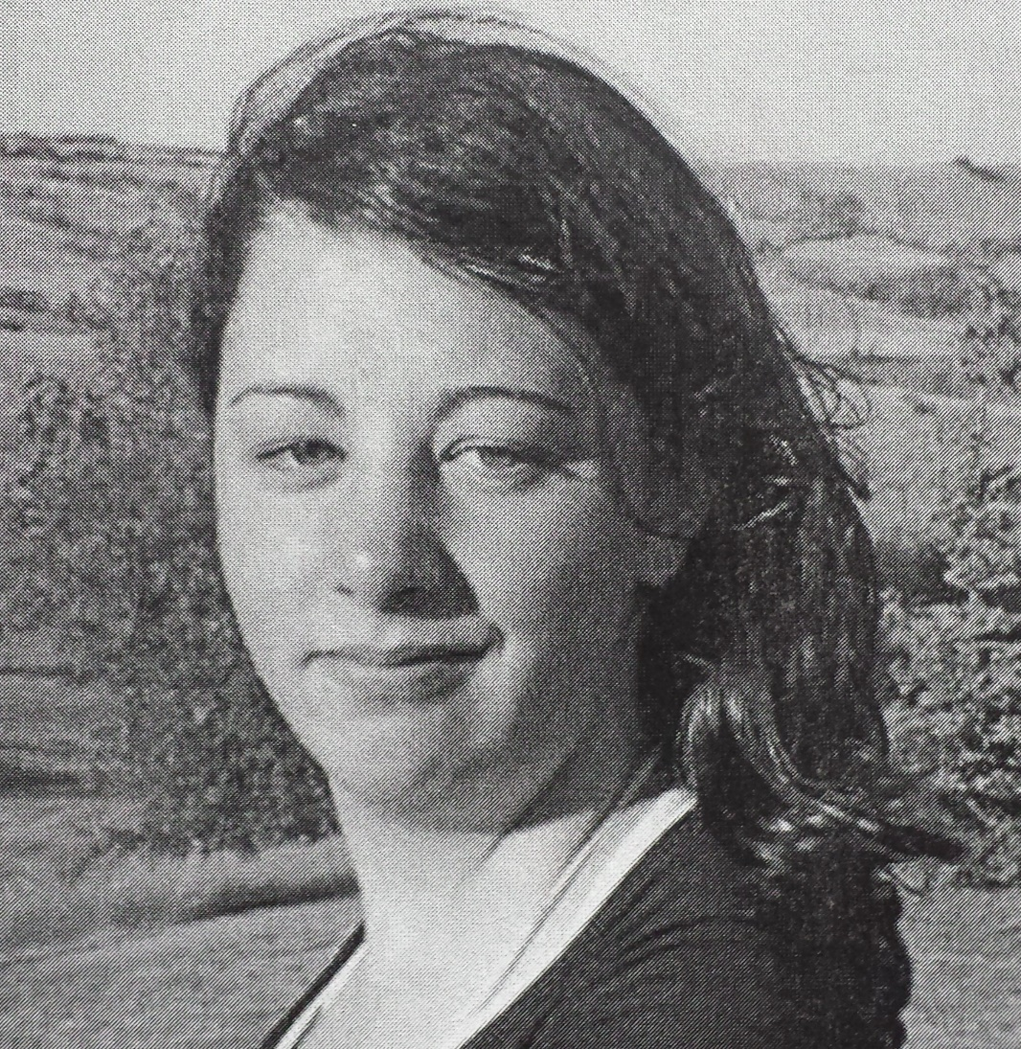
Vanessa
A different kind of coming home?
An Epiphany at Psychiatric Rehab

Slide 23
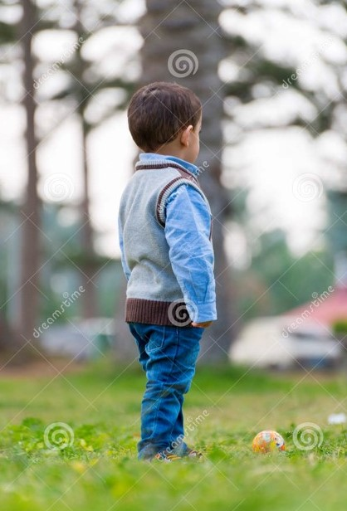
4 Year old with Autism
What is home?

Slide 24
17 Year old with Anxiety
Question of Orientation
A sense of belonging in this life is not so simple for many?
We have come along way in correcting the external aspects in life. It is now time for some work on the internal aspect of our world.

Slide 25
A friend’s child with mental health issues
Bringing home a child or is it bringing home a problem?
Contained Chaos

Slide 26
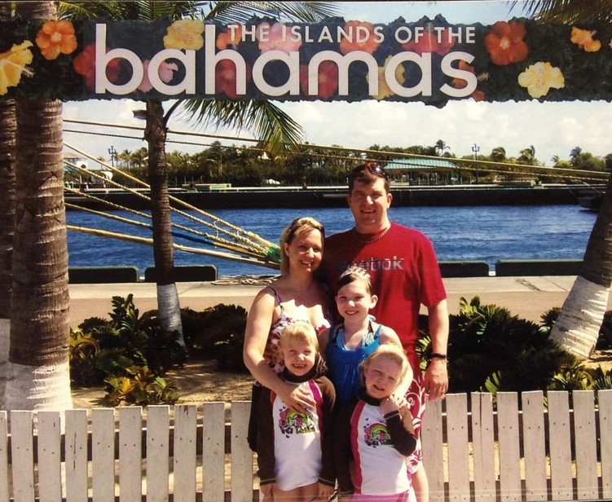
A Dad’s return home
45 Year old, Robert Lewis with his wife and 3 children

Slide 27
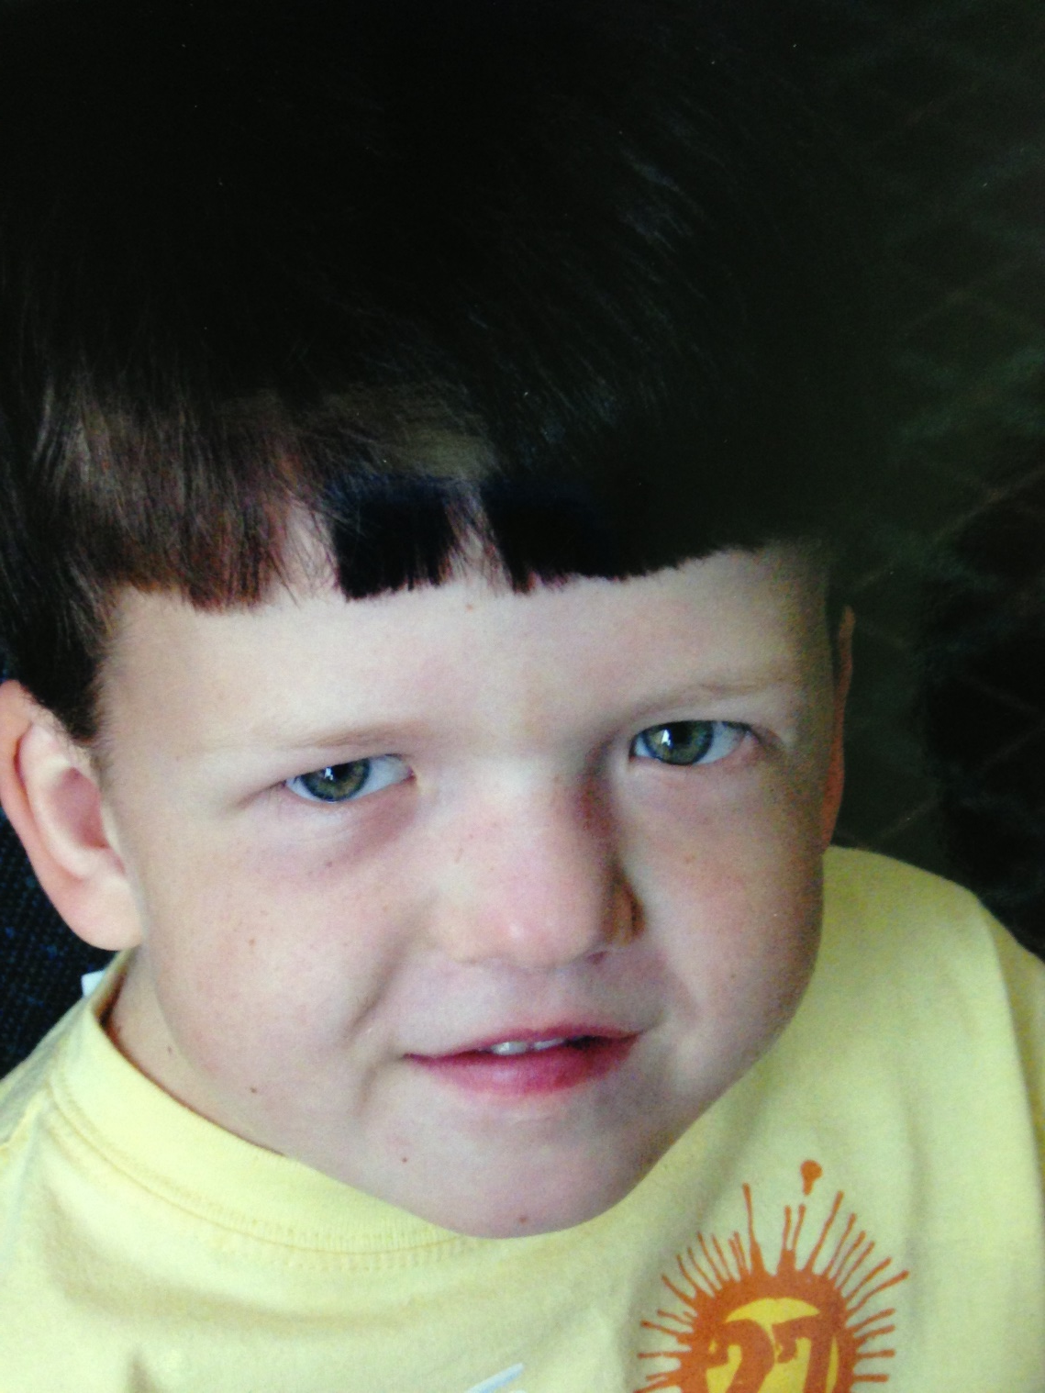
William and His Coming Home
Finding his identity
Noonans Syndrome

Slide 28
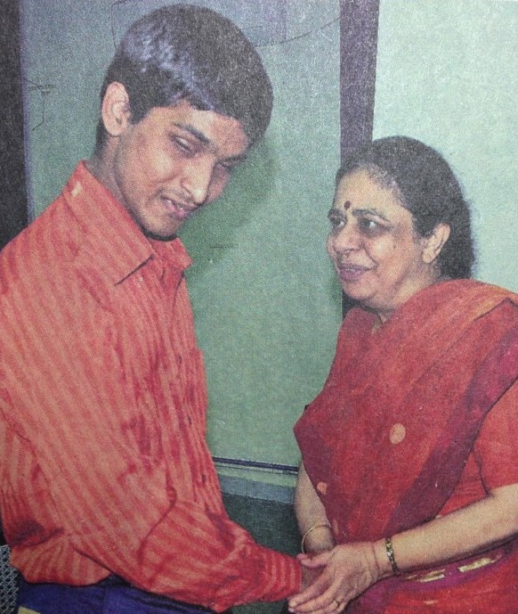
A Blind Boy
If you could make one wish what would you wish for?
Making it to MIT and BACK home

Slide 29
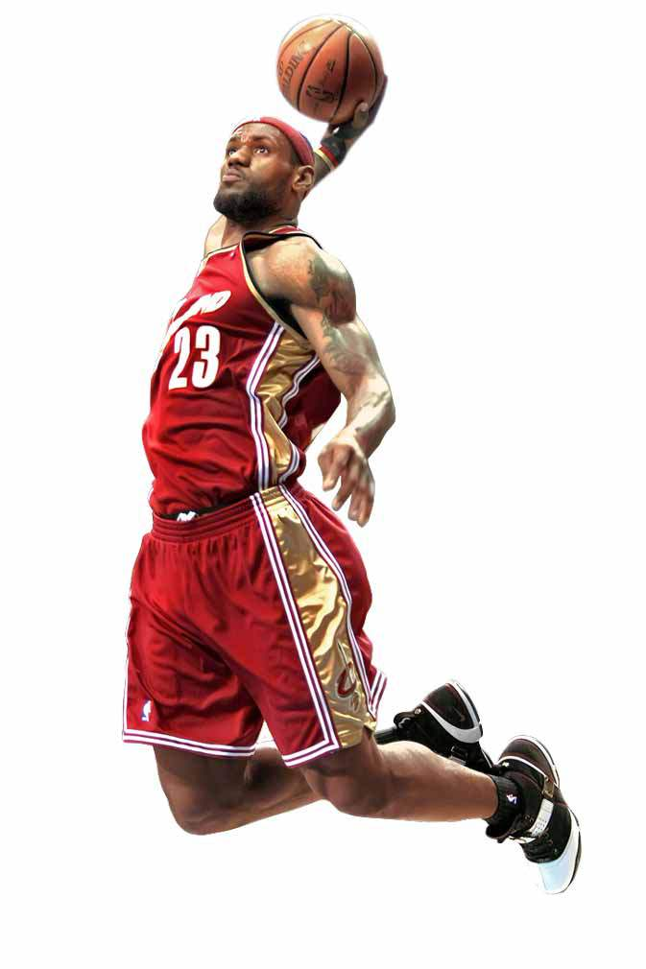
Is home a place or a state of mind?
A Home is a symbol
A Coming Together of Dreams, Unconditional Love
& Finding Ones Identity

Slide 30
A Coming Together of All Elements
Thoughts
Emotions Beliefs
Feelings
Grace Wellbeing
Compassion
Mindfulness Companionship
Anger
Forgiveness Gentleness

